Slide 1


For Beginner
By :- RAHUL JOGRANA
www.dotnetlab.in
www.aspnetinhindi.blogspot.com
Twitter:- @thejograna
Github:- github.com/rahuljograna
Part 9 radio button in ionic

Slide 2

Radio button in ionic
Like the checkbox, a radio is an input component that holds a boolean value. Under the hood, radios are no different than HTML radio inputs. However, like other Ionic components, radios are styled differently on each platform. Unlike checkboxes, radio components form a group, where only one radio can be selected at a time. Use the checked attribute to set the default value, and the disabled attribute to disable the user from changing to that value.

Slide 3
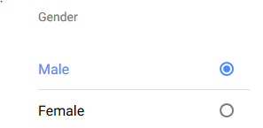
Radio button in ionic

Slide 4
Let’s start

Slide 5
To learn new Technology along with Example like
ASP.NET, ASP.NET MVC, AngularJS, ASP.NET Web API
From Beginners visit my Youtube channel and steps and Source code is
Available on My Blog and Web site
To Get notification for new updates Subscribe my YOUTUBE Channel.
Source Code :- http://aspnetinhindi.blogspot.com
Website :- http://www.dotnetlab.in
Github :- https://github.com/rahuljograna
Twitter :- twitter.com/thejograna
Mail :- rahuljograna007@gmail.com
WhatsApp Number :- 9426585554

Slide 6
To Develop Application
Contact me
Mail me : rahuljograna007@gmail.com
Mobile : +91 9426585554
whatsApp : +91 9426585554

